Slide 1
THE UNIVERSITY OF ARIZONA LIBRARIES Jim Martin, Associate Librarian, djmartin@arizona.edu
UA Libraries Services & Resources

Slide 2
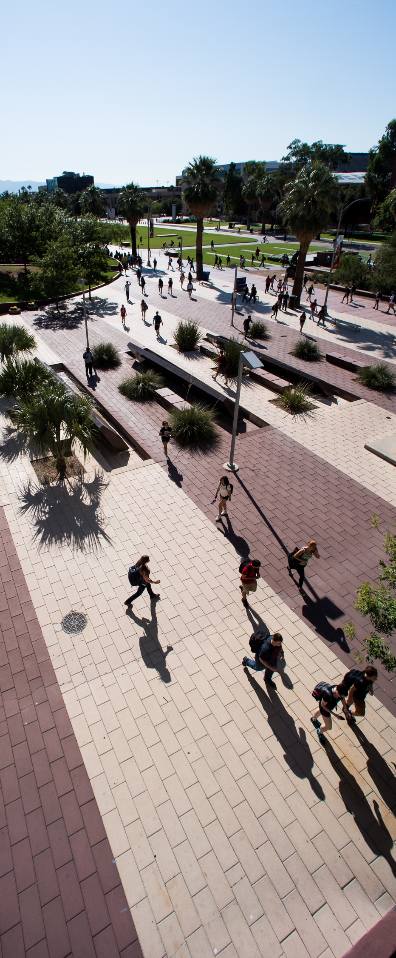
CATalyst Studios
Maker Studio, Main Library B203
Virtual Reality Studio, Main Library B202
Media Recording Studio (inside the Virtual Reality Studio), Main Library B202B
Data Studio, Main Library B201

Slide 3
Tools for Research
Ebook & Article Databases : Scopus, IEEEXplore, SPIE Digital Library
DMPTool (Data Management)
Open Science Framework (OSF) & ReDATA, Open Access

Slide 4
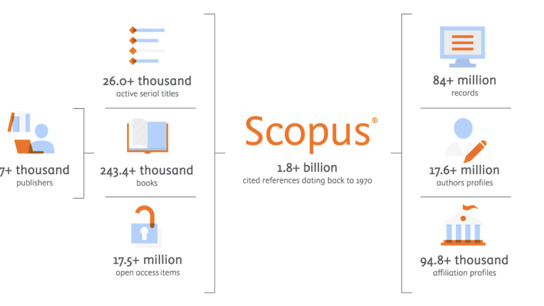
SCOPUS
The four main Scopus analysis tools:
Analyze Results
View Citation Overview
Browse Source & Compare Journals
Scopus Profiles – Analyze Author output

Slide 6
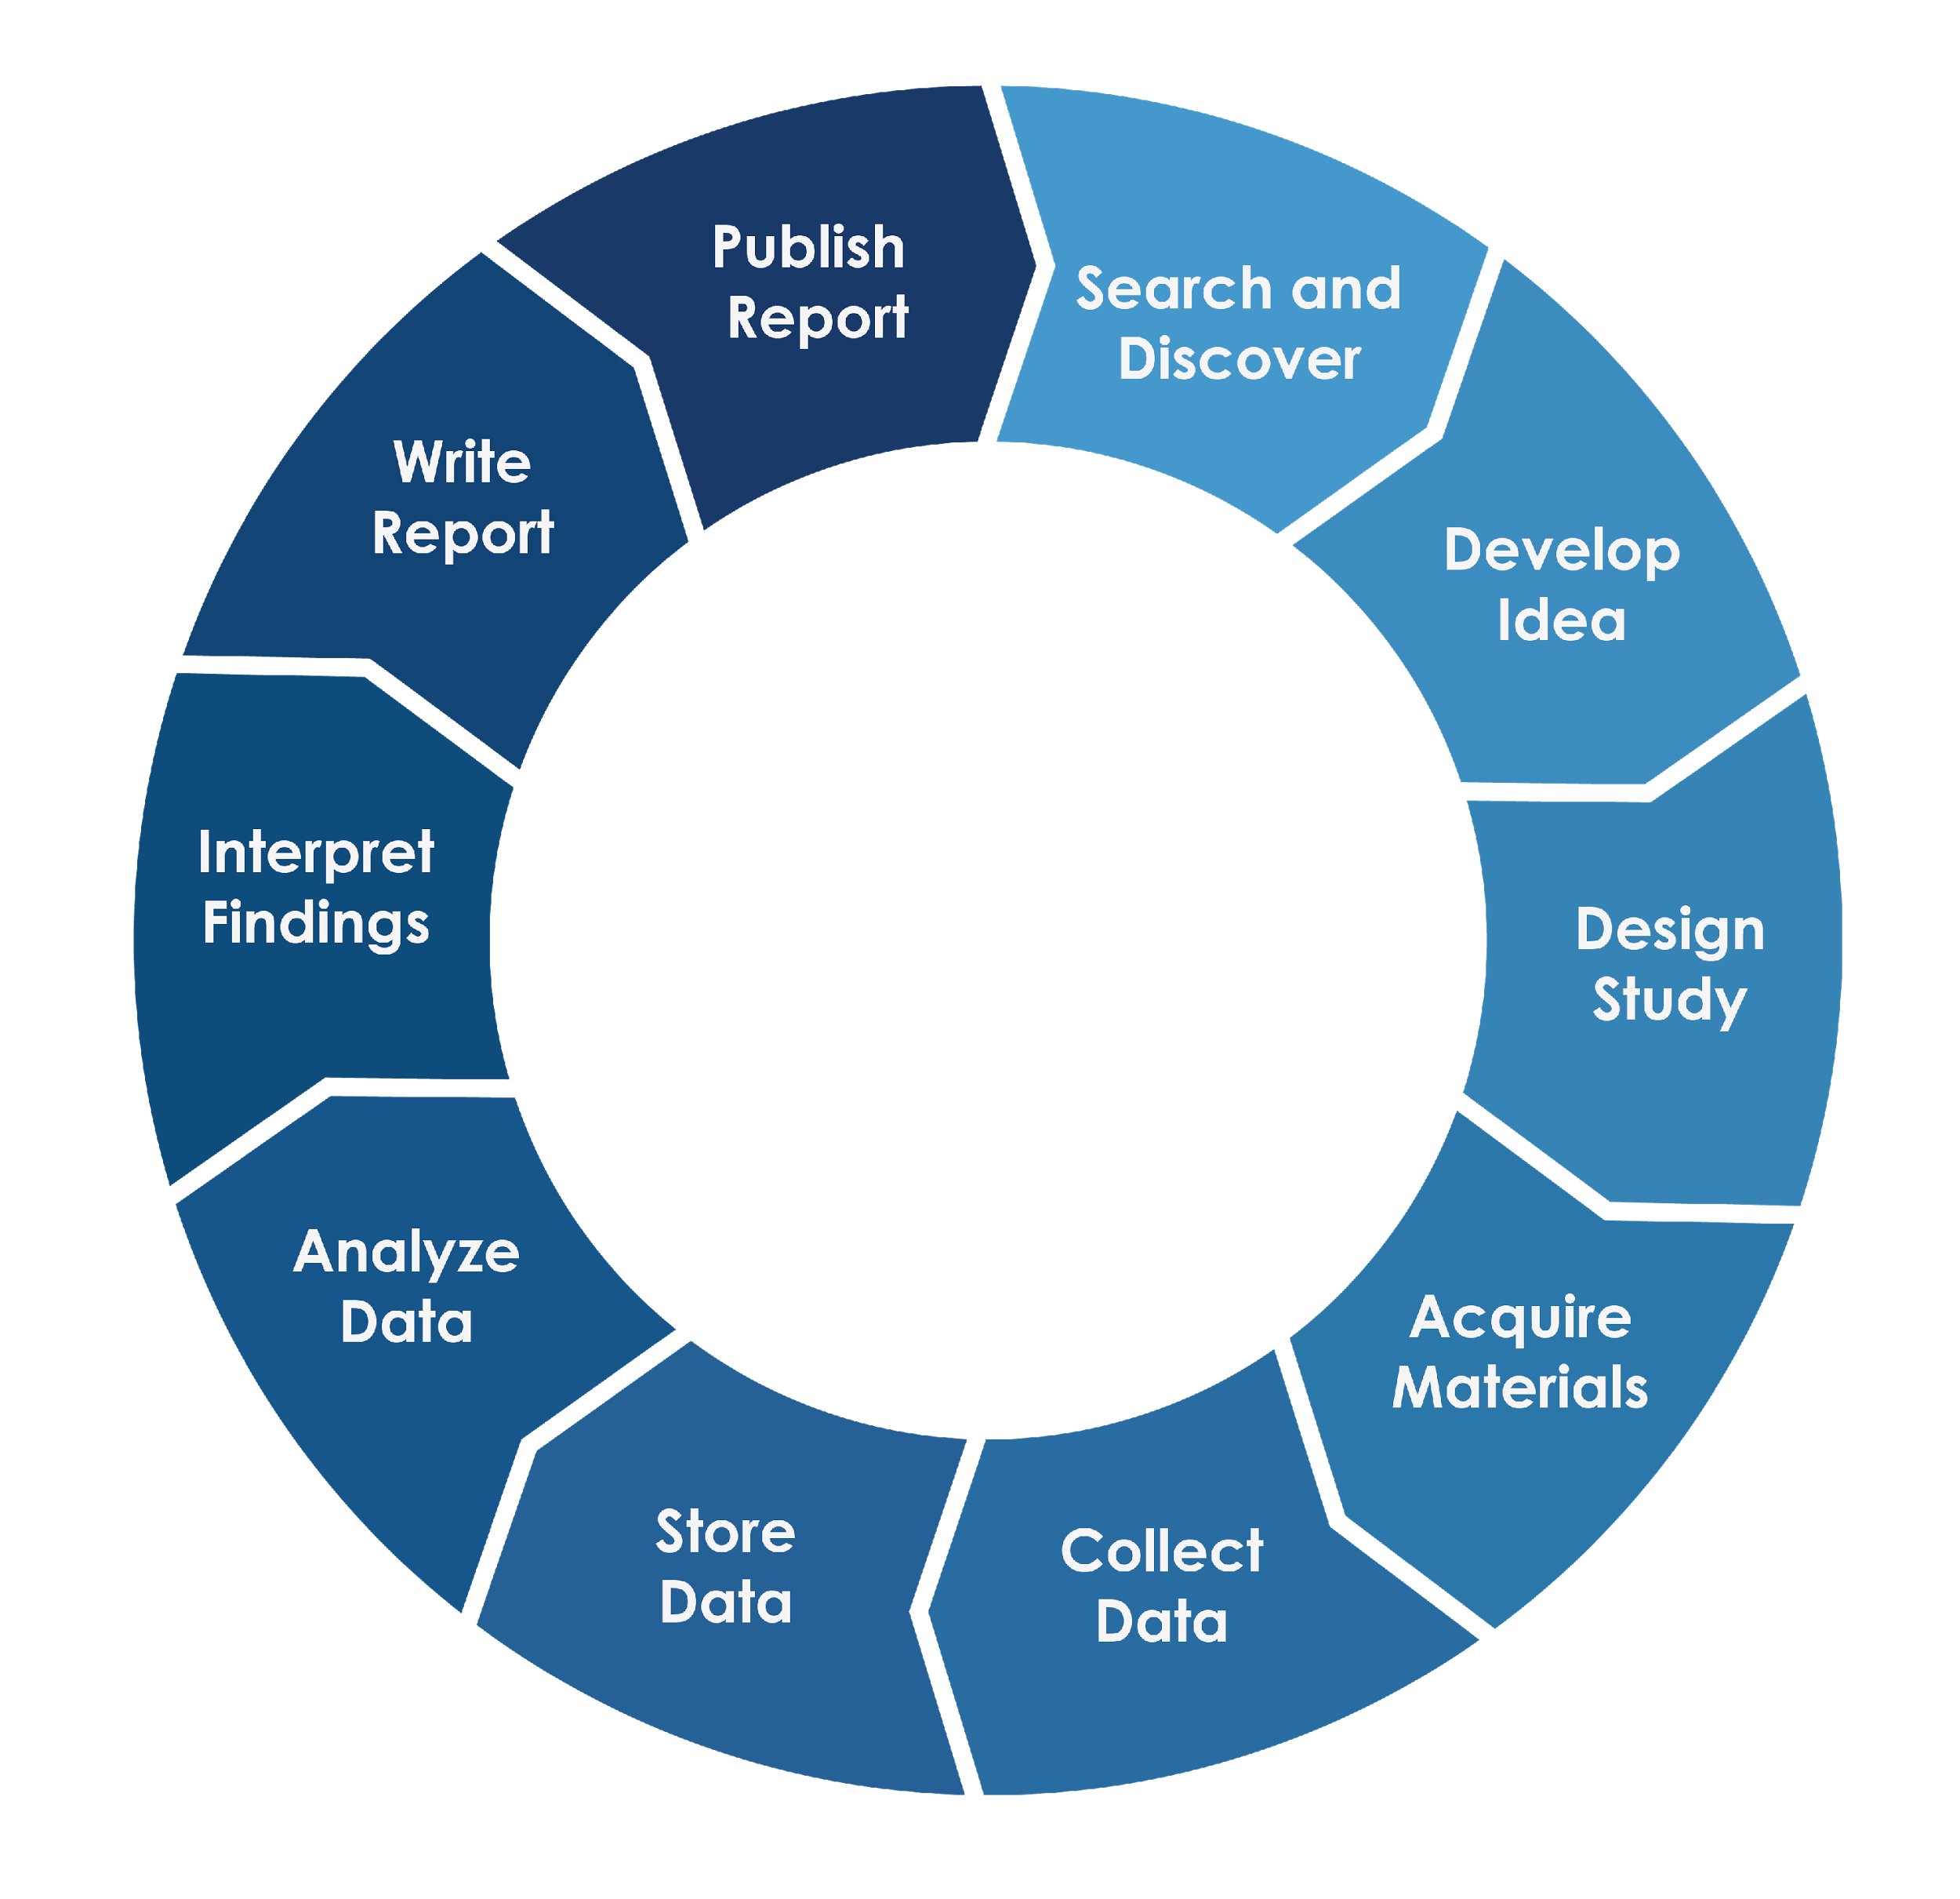
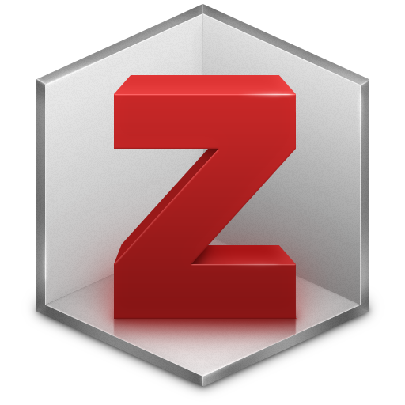
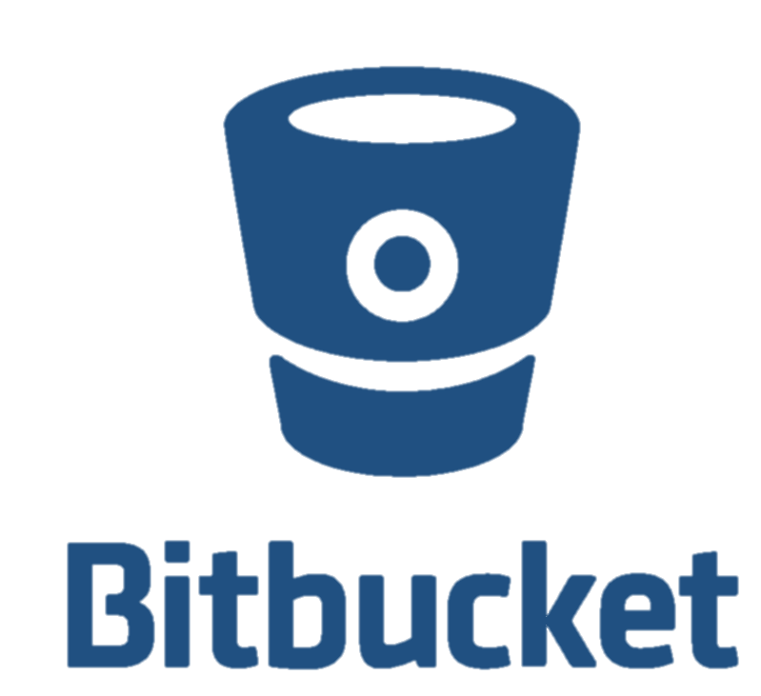
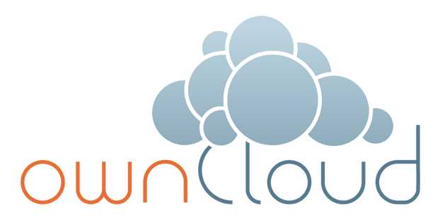
The Open Science Framework
http://osf.arizona.edu
OSF
Sign-on with NetID
Notes:
OSF is a research collaboration platform that is freely available to all researchers. It allows for the management and sharing of research projects at all stages of research. It is capable of integrating with many tools and services you already use such as Box, Github, Google Drive, and many others so that you can continue to work within your existing workflow. Even though it has "open" in the name, projects on the OSF are private by default and making them open is optional.
Organize and optionally share all the files for a paper.
Set up a lab page
Share documents, data, and code with collaborators
Electronic lab notebook
Workshop or conference page

Slide 7
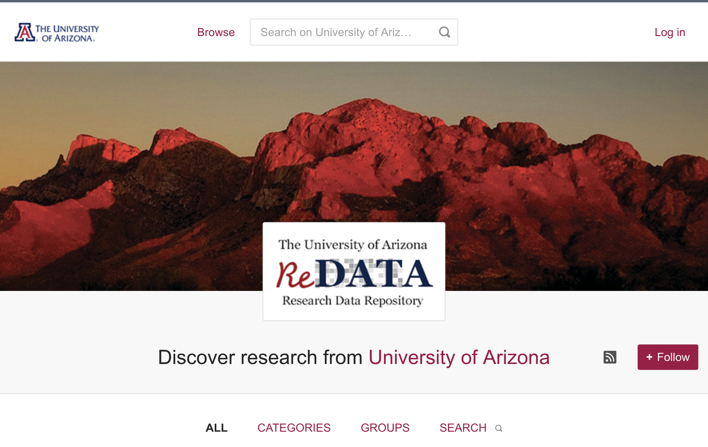
ReDATA : The UA Research Data Repository
https://arizona.figshare.com/

Slide 8
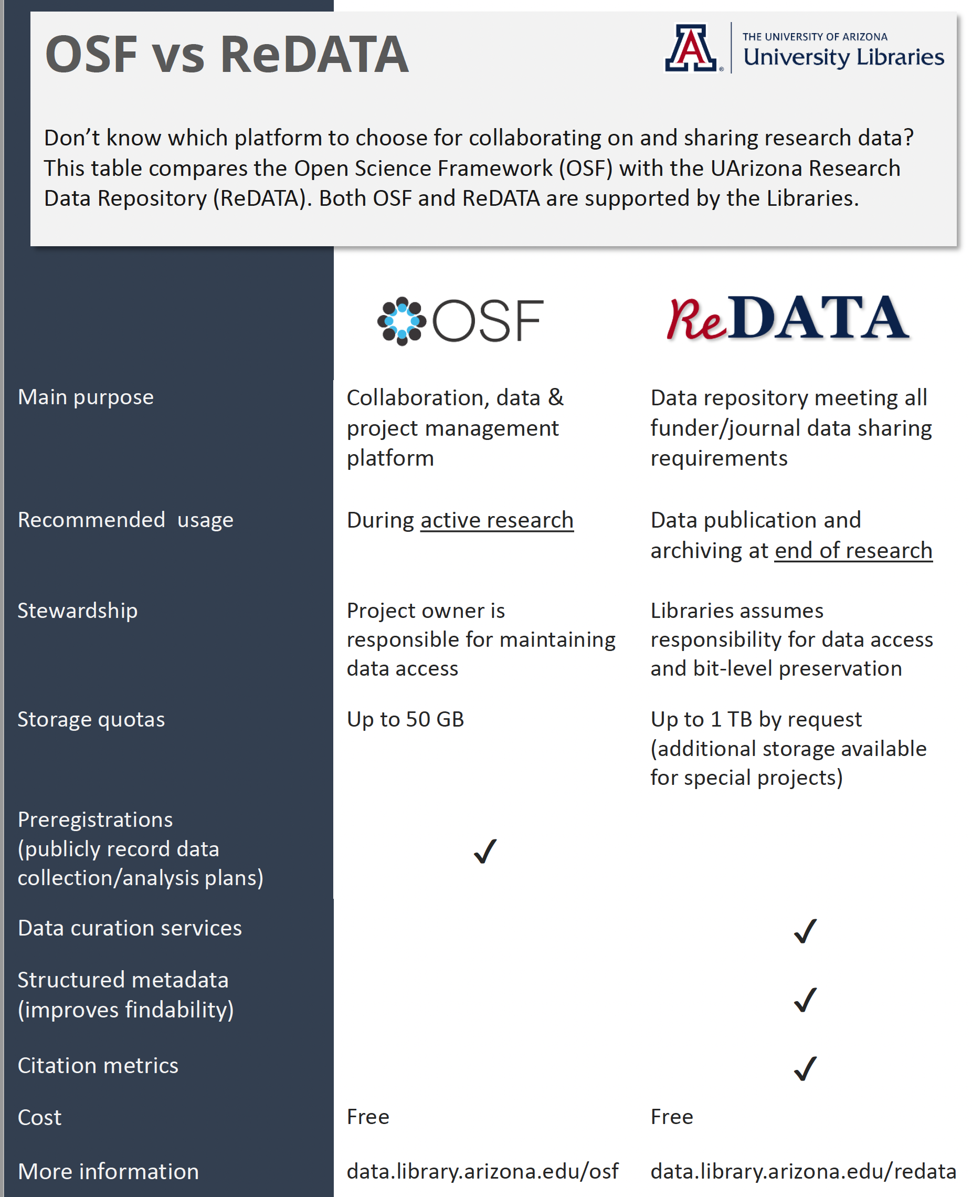

Slide 9
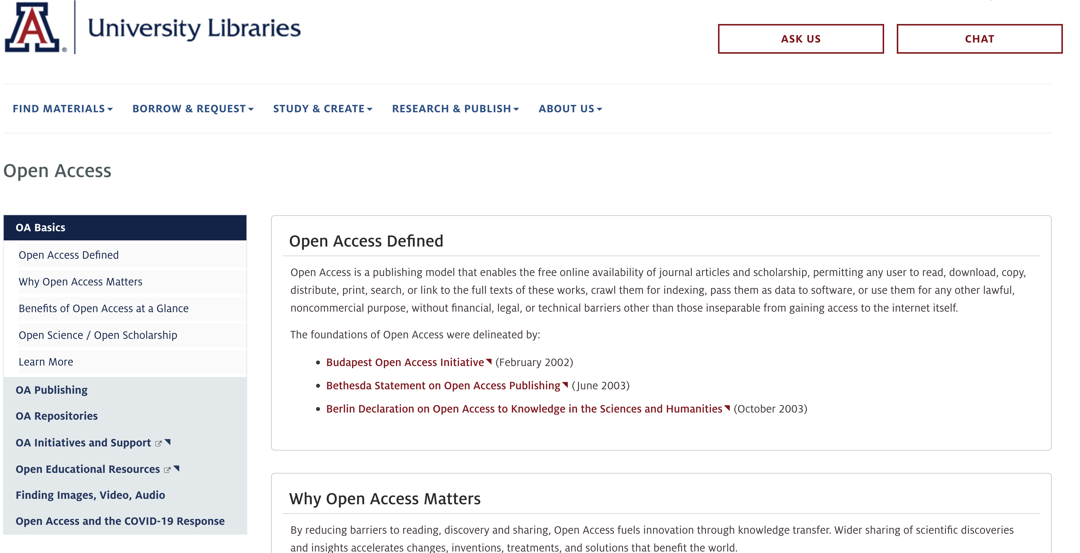
Open Access
https://libguides.library.arizona.edu/c.php?g=940496

Slide 10
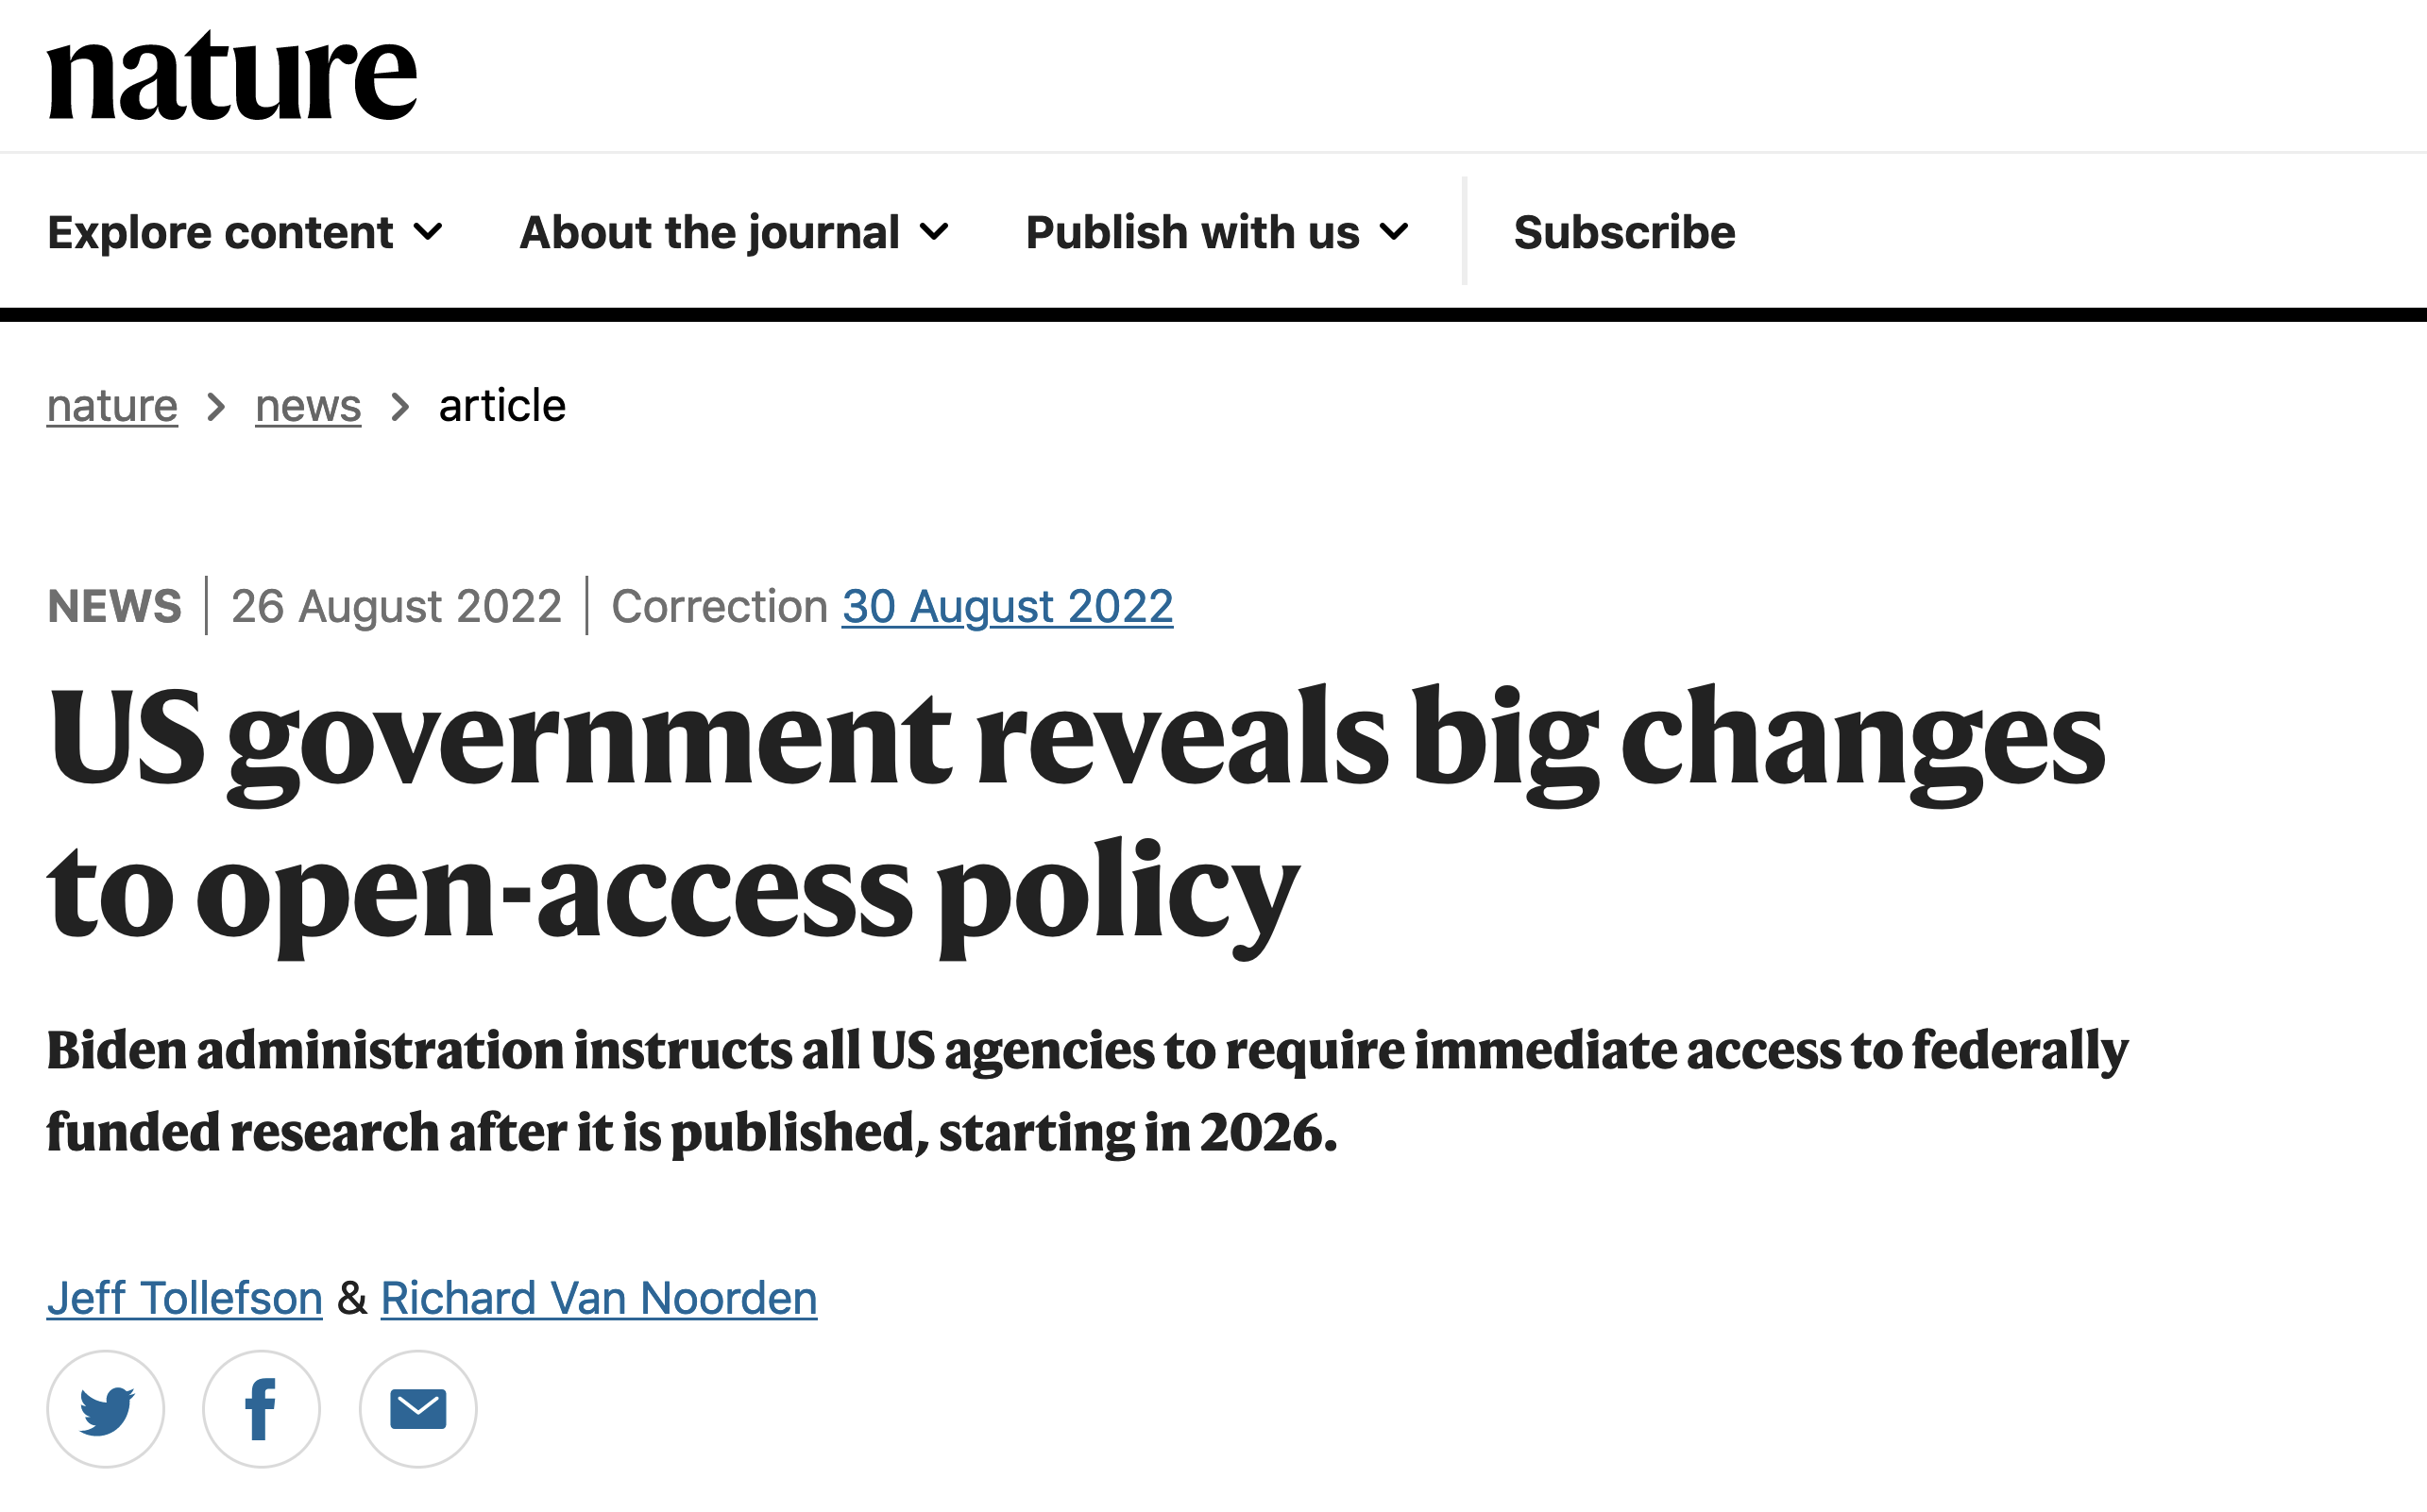
UA Library Open Access Investment Fund
The UA Library’s Open Access Investment Fund has a twofold purpose:
Support of UA-affiliated author publication costs: Through the Library’s institutional memberships with specific publishers, UA authors benefit from pre-arranged discounts or waivers on article processing charges.
Support of initiatives and projects that advance open access: The Library will commit funding in memberships and initiatives that have wide potential global impact, such as projects that develop open publication infrastructure or that convert portfolios of subscription-based peer-reviewed journals to open access.
Suggestions?
Do you know of an open access project that you think we should support? Have you heard of another publisher that offers pre-arranged discounted article processing charges? Please share your ideas about how the Library can promote open access. Contact us at open-access@email.arizona.edu.
https://new.library.arizona.edu/about/awards/oa-fund

Slide 11
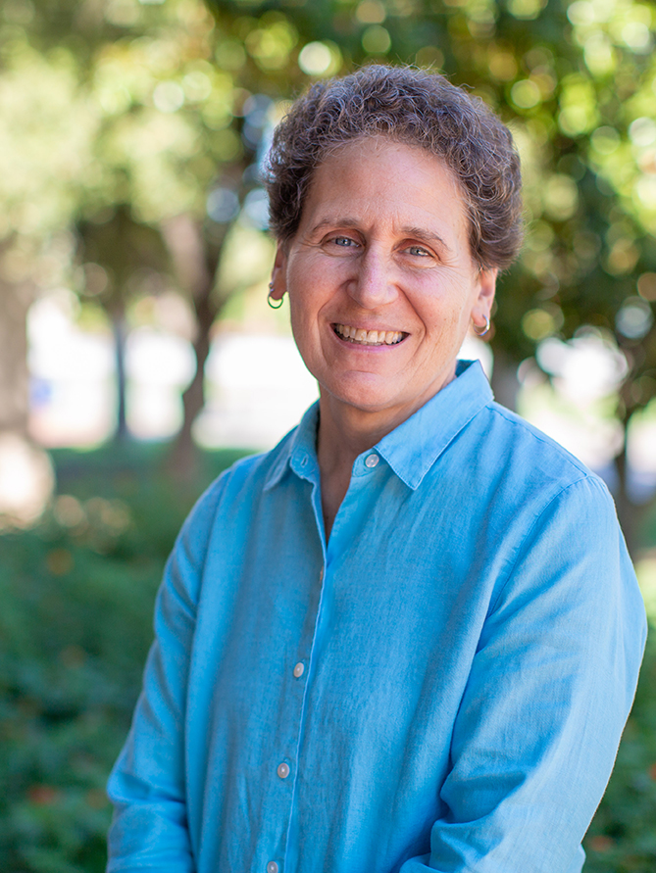
Scholarly Communications
HOW YOU CAN SUPPORT OPEN RESEARCH
October 26, 2022 at 10 am. Online.
OPEN ACCESS & PREDATORY PUBLISHING
October 27, 2022 at 12 pm. Online.
COPYRIGHT FOR GRADUATE STUDENTS
November 8, 2022 at 1 pm. Online.
The workshop will cover: What copyright is and what copyrights you have in your work; Using third-party works in your writing, including using public domain and openly licensed works, relying on fair use, and securing permission; Depositing your dissertation or thesis online; Considerations when signing a publication contract.
Ellen Dubinsky
Scholarly Communication Librarian
edubinsky@arizona.edu

Slide 12
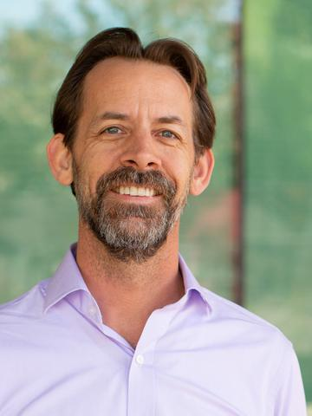
DATA SCIENCE
DATA & VIZ DROP-IN
Support for R, Python, and data visualization
Every Tuesday morning, 9-11am
Data Studios of Main Library and online
https://libcal.library.arizona.edu/event/9325843
DATA ANALYSIS & VISUALIZATION IN R
Workshops every other Tuesday morning, 9-11am
Data Studios of Main Library and online
Schedule: https://jcoliver.github.io/learn-r/schedule
https://libcal.library.arizona.edu/event/9325843
DATA SCIENCE AMBASSADORS
Supporting campus data science literacy
https://datascience.arizona.edu/dsa
Jeff Oliver
Data Science Specialist
jcoliver@arizona.edu
https://data.library.arizona.edu

Slide 13
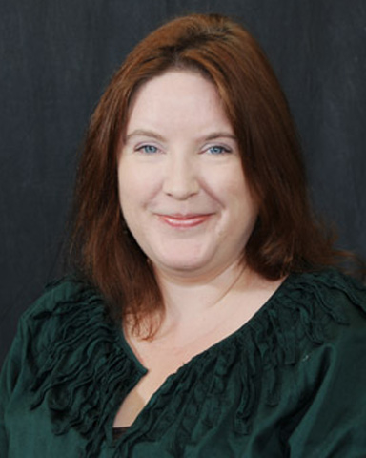
UA Campus
Repository
DO YOU WANT TO SHARE, ARCHIVE AND PRESERVE YOUR RESEARCH FOR NOW AND THE FUTURE?
ARE YOU LOOKING FOR A PUBLIC & PERMANENT LOCATION FOR YOUR SCHOLARLY OUTPUTS?
The UA Campus Repository is a publicly available institutional repository supporting the widest possible dissemination of UA research and scholarship. The repository is a no-cost service managed by the UA Libraries.
Types of content eligible for inclusion include:
Published articles, proceedings, book chapters, books
Presentations, working papers, project reports, technical reports
College, unit, departmental publications
Details with dates, times, locations, links, etc.
Kimberly Chapman
Campus Repository Services
kimberlychapman@arizona.edu
https://repository.arizona.edu/

Slide 14
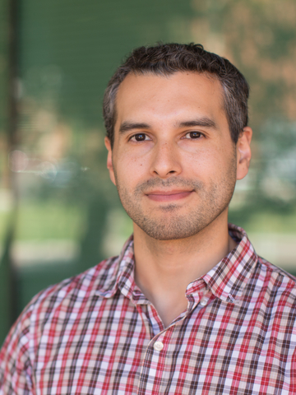
Data Management Consulting
Data & Viz Office hours Every Tuesday Morning 9-11 am
Drop-in to get help on data management, data science, and data visualization. Data management is virtual only. https://libcal.library.arizona.edu/event/9325839
UA Research Data Repository Training
November 16, 11a-12p
Learn about the University of Arizona Research Data Repository (ReDATA) and how you can use it to archive and share research datasets after the conclusion of your research projects while remaining in compliance with University, funder, policies as well as publisher requirements for obtaining Digital Object Identifiers (DOIs) for datasets. https://libcal.library.arizona.edu/calendar/events/ReDATA_trainingFall2022
Fernando Rios, PhD
Research Data Management Specialist
Frios@arizona.edu
data.library.arizona.edu/data-management

Slide 15
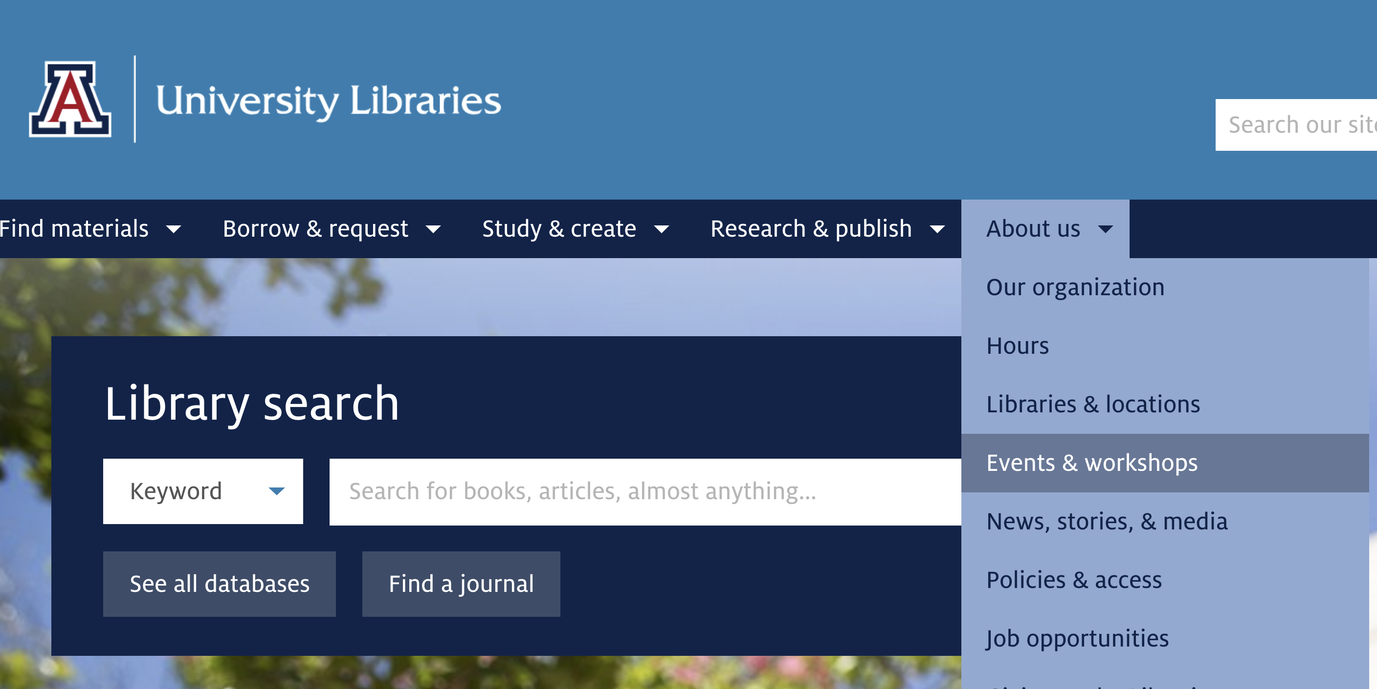
Library Events & Workshops

